Slide 1

Automatic Music Organization System
(Island of Music)
BTP Presentation: Phase 2
Abhinav Singh and Ashna Dhanda
Supervisor: Dr. S.R.M Prasanna
Bachelor of Technology Program,
Electronics and Communication Department,
Indian Institute of Technology,
Guwahati, Assam.

Slide 2
Contents
Summary of Work done in first phase.
Extension of the Work from Phase 1.
Related Works
  Content Based Music Retrieval
  Approaches using Self-Organizing Maps (SOM)
Our Automatic Music Organization System
  Feature Extraction
    Loudness Sensation
      Discrete Fourier Transform
      Critical Bands
      Masking
      Decibel, Phon and Sone
      System Architecture for Sone Calculation
      System Architecture for Sonogram Calculation

Slide 3
Contents (Continued……)
Our Automatic Music Organization System (Cont.)
  Feature Extraction
    Dynamics
      Amplitude Modulated Loudness
      Fluctuation Pattern (FP) Strength
      System Architecture for FP Calculation
    Periodic Histograms (PH)
      System Architecture for PH Calculation
  Clustering
    Self Organizing Maps (SOM)
      Background
      The Batch SOM Algorithm
  Visualization and User Interface
    Island of Music (IOM)
Conclusion and Future work
References

Slide 4
Summary of Work done in First Phase
Automatic Genre Classification of Audio Signals
Rock
Music Database
Classical
Pop
Electronica
Jazz

Slide 5
Summary of Work done in First Phase (Cont…)
Following was the block diagram of our Classification System:
audio file
Feature Extraction
Training
Classification Scheme
Testing
Codebook Database
Comparision
Classified Output

Slide 6
Summary of Work done in First Phase (Cont…)
Feature Extraction
  Mel-Frequency Cepstral Coefficients (MFCC’S)
  Log Compressed Energy
Classification Scheme
  Vector Quantization and K-Means

Slide 7
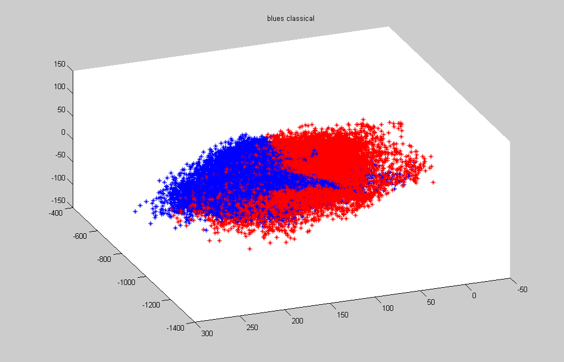
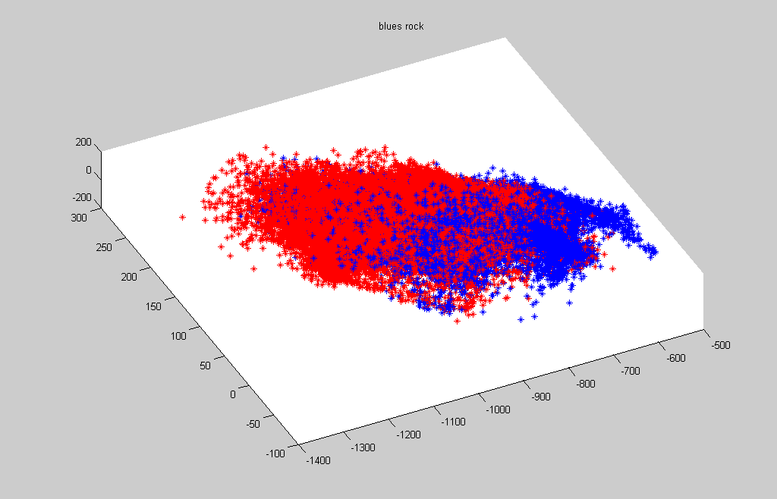
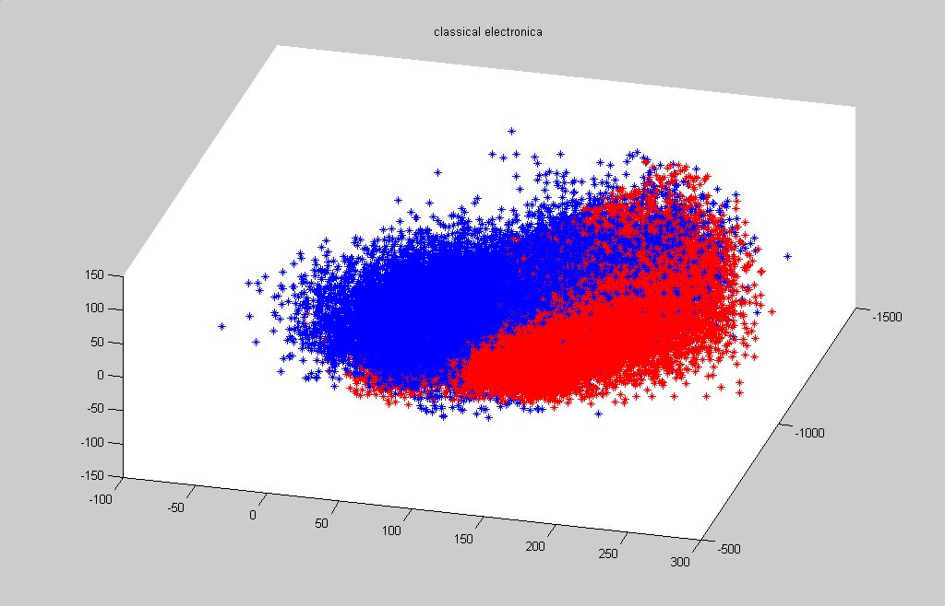
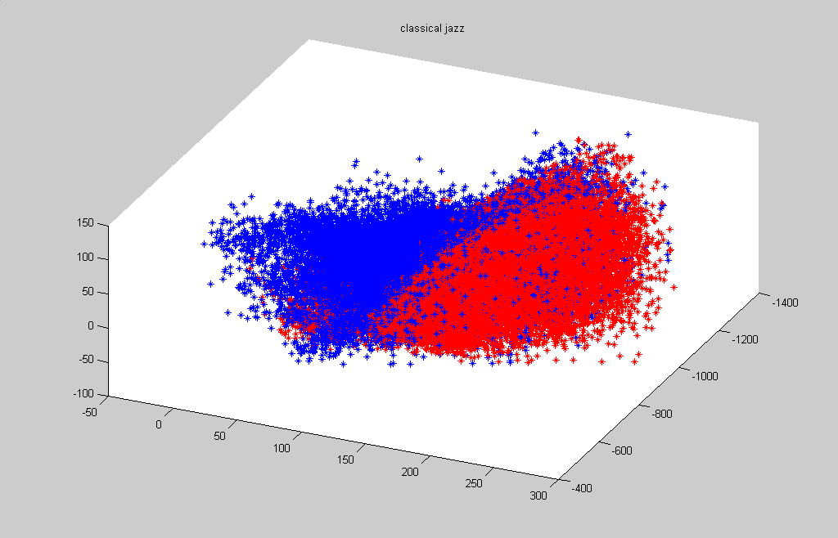
Summary of Work done in First Phase (Cont…)
MFCC Feature Vector Results
Blues vs. Classical
Blues vs. Rock
Classical vs. Electronica
Classical vs. Jazz

Slide 8
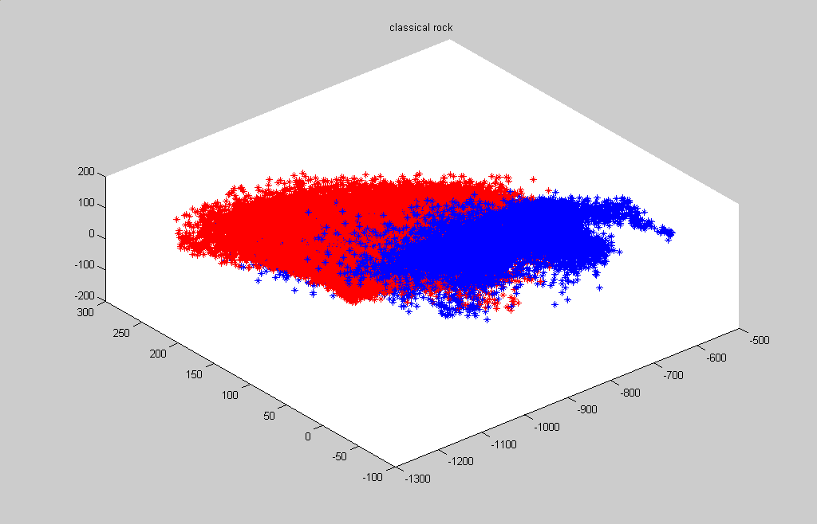
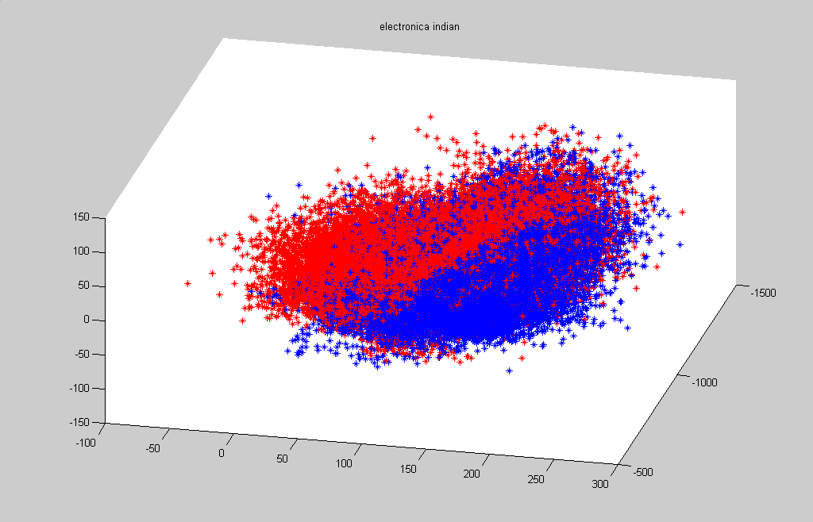
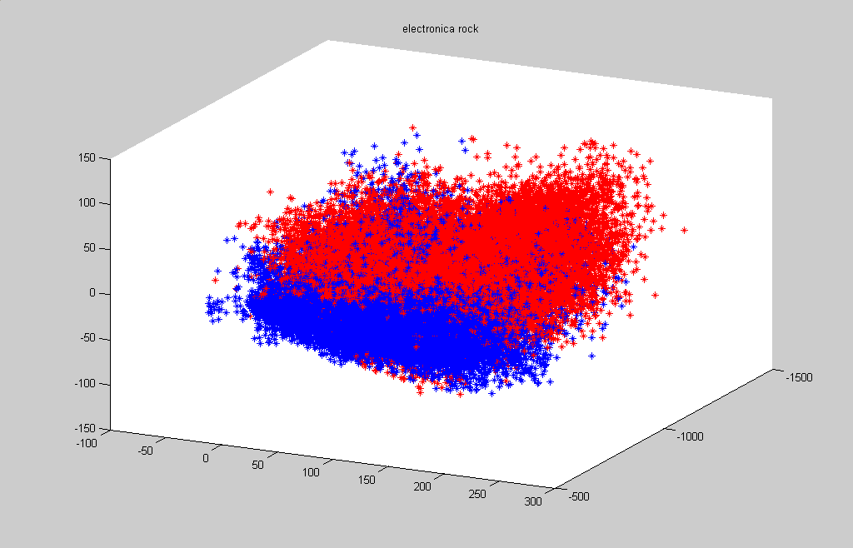
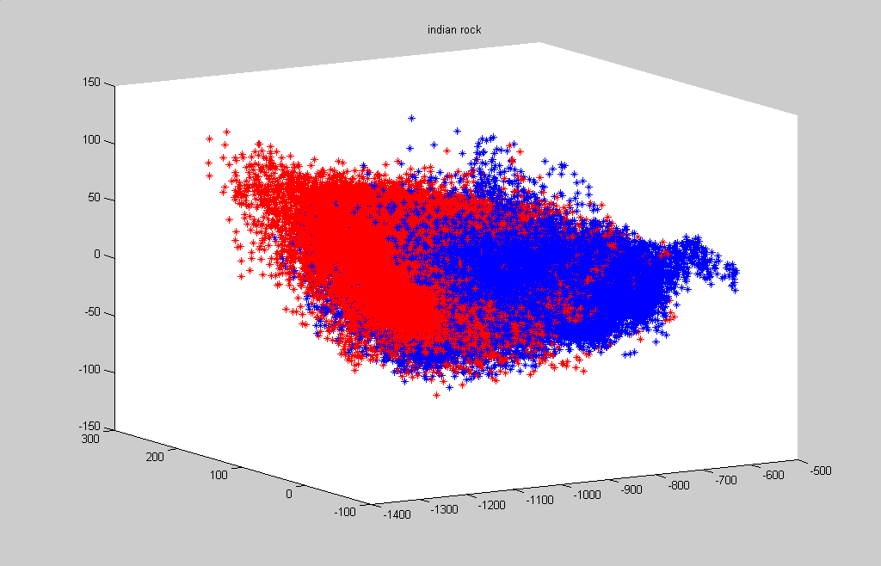
Summary of Work done in First Phase (Cont…)
Log-Compressed Energy Feature Vector Results
Electronica vs. Ambient
Classical vs. Rock
Electronica vs. Rock
Ambient vs. Rock

Slide 9
Summary of Work done in First Phase (Cont…)
Results using MFCC’s
Confusion Matrix Obtained using MFCC as feature vectors
 | Am | Blu | Cla | Ele | Fol | Jaz | Nag | Rap | Roc
Am | 64 | 0 | 12 | 6 | 6 | 6 | 4 | 2 | 0
Blu | 0 | 76 | 0 | 6 | 2 | 6 | 0 | 0 | 10
Cla | 0 | 0 | 96 | 0 | 0 | 0 | 2 | 2 | 0
Ele | 0 | 0 | 2 | 94 | 0 | 2 | 2 | 0 | 0
Fol | 0 | 2 | 6 | 0 | 88 | 2 | 2 | 0 | 0
Jaz | 0 | 0 | 0 | 6 | 0 | 88 | 0 | 6 | 0
Nag | 2 | 3 | 15 | 0 | 3 | 10 | 67 | 0 | 0
Rap | 0 | 1 | 0 | 5 | 0 | 0 | 0 | 90 | 4
Roc | 0 | 0 | 0 | 2 | 2 | 5 | 0 | 6 | 85
Am=Ambient, Blu=Blues, Cla=Classical, Ele=Electronic, Fol=Folk, Jaz=Jazz, Nag=New-Age, Roc=Rock

Slide 10
Summary of Work done in First Phase (Cont…)
Results using Log-Compressed Energies
Confusion Matrix Obtained using Energy as feature vectors
 | Am | Blu | Cla | Ele | Fol | Jaz | Nag | Rap | Roc
Am | 74 | 0 | 10 | 4 | 4 | 4 | 4 | 0 | 0
Blu | 0 | 80 | 0 | 4 | 0 | 6 | 0 | 0 | 10
Cla | 0 | 0 | 96 | 0 | 0 | 0 | 0 | 4 | 0
Ele | 0 | 0 | 0 | 96 | 0 | 0 | 4 | 0 | 0
Fol | 0 | 2 | 4 | 0 | 92 | 0 | 2 | 0 | 0
Jaz | 0 | 0 | 0 | 4 | 0 | 90 | 0 | 6 | 0
Nag | 3 | 0 | 13 | 0 | 2 | 7 | 74 | 0 | 0
Rap | 0 | 2 | 0 | 5 | 0 | 0 | 0 | 90 | 3
Roc | 0 | 0 | 0 | 5 | 0 | 1 | 0 | 6 | 88
Am=Ambient, Blu=Blues, Cla=Classical, Ele=Electronic, Fol=Folk, Jaz=Jazz, Nag=New-Age, Roc=Rock

Slide 11
Extension of the Work from Phase 1
Goals achieved in Phase 1
  Extracting timbre information from the audio signal using MFCC.
  Representing energy attributed using Log-Compressed Energies.
  Classification of Audio Database into 9 different genres.
  A classification accuracy of over 85 % was achieved.
Issues left unsolved in Phase 1
  Classification of audio database was done in different genres, hence a pop based song played by a rock band still found place under rock category.
  For eg. ‘Nothing else Matters’ by Metallica still found place under rock category while mood wise it is quite similar to ‘Coming Back to life’ or ‘Comfortable Numb’ by Pink Floyd.

Slide 12
Extension of the Work from Phase 1 (Cont …)
Issues left unsolved in Phase 1
  In phase 1 we only used the timbral and energy based features to represent a piece of audio signal. Using dynamic and temporal features can give a better representation of an audio piece.
Issues targeted in the current Phase
  The availability of large music collections calls for ways to efficiently access and explore them. We present an approach which combines descriptors derived from audio analysis with meta-information to create different views of a collection. Such views can have a focus on timbre, rhythm, artist, style or other aspects of music. For each view the pieces of music are organized on a map in such a way that similar pieces are located close to each other. The maps are visualized using an Islands of Music metaphor where islands represent groups of similar pieces.

Slide 13
Related Works - Content Based Music Retrieval
The necessary metadata information description standards are provided by MPEG 7^{[1]}. A system based on MPEG 7 has been presented by G.Peeters^{[2]}.
Text Document retrieval search for music, using lyrics as the input keyword has been explored by websites BigLyrics.com and LyricsCrawler.com . They use 2-D map display method, generated using SOMLib^{[3]} or the WebSOM^{[4]}.
An Overview of systems analyzing audio databases was presented by Foote^{[5]}.
Several studies and overviews related to content-based audio system classification are available in M.Liu^{[6]}.
J.T.Foote^{[7]} and B.Logan^{[8]} have presented approaches based on MFCC’s.
Recently, Scheirer^{[9]} presented a model of human perceptual behaviors and briefly discussed how his model can be applied to classifying music into genre classification and performing music similarity-matching.

Slide 14
Related Works – Approaches using SOM
Our work has been developed upon the work of Fruhwirth and Rauber^{[10]}. In their work they have used SOM^{[11]}.
We have tried to combine the well working approach with psychoacoustic methods. An overview of psychoacoustics can be found in E.Zwicker^{[12]}.

Slide 15
Feature Extraction – Loudness Sensation
Loudness belongs to the category of intensity sensation.
The 1 kHz tone is a very popular reference tone in psychoacoustics, and the loudness of the 1kHz tone at 40 dB is defined to be 1 Sone. A sound perceived to be twice as loud is defined to be 2 Sone and so on.
To calculate the loudness sensation from raw audio several transformations are necessary:
  Discrete Fourier Transformation (DFT)
  Bundling according to nonlinear critical-band rate scale (Bark)
  Then Spectral masking effects are applied before decibel values are calculated
  Decibel values are transformed into equal loudness levels (Phons)
  Finally the specific loudness sensation is calculated (Sone)

Slide 16
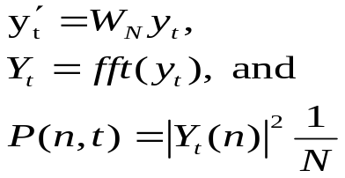
Feature Extraction – Loudness Sensation
Discrete Fourier Transformation
  Music data sampled at 22050 Hz is used for the experiments
  Frame duration of 23 msec (512 samples) is considered for analysis with an overlap of 50 %
  It results in frequency resolution of about 43 Hz in a range from 0 to 11 kHz
  A 50 % overlap increases the time resolution by a factor 2 to about 12 msec
  For a raw audio data frame y(t) of length N, power spectrum P(n;t) can be calculated using (a more detailed description is in Brigham^{[15]}):

Slide 17
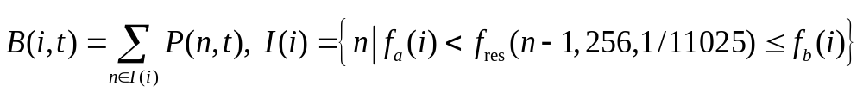
Feature Extraction – Loudness Sensation
Critical Bands (Bark)
  So far piece of music is represented by frequency snapshot every 12 msec. These also have values every 43 Hz starting from 0 Hz to 11 kHz
  Inner ear can be regarded as complex system of band-pass filters. These properties have been analyzed throughout several psychoacoustic experiments by E.Zwicker^{[12]}
  Zwicker studied, while we can distinguish low frequency up to about 500 Hz well, our ability decreases above 500 Hz
  A critical band value within lower f_{a}(i) and upper f_{b}(i) frequency limits of the i^{th} critical band can be formulated as:

Slide 18
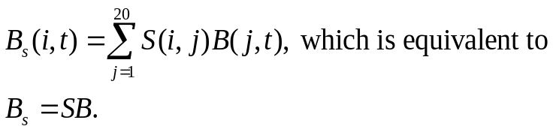
Feature Extraction – Loudness Sensation
Spectral Masking
  Masking is the occlusion of one sound by another sound. Eg. A loud sound might mask a simultaneous sound (simultaneous masking), or a sound closely following (post-masking) or preceding (pre-masking) it
  Spreading function is used to estimate the effects of simultaneous masking across the critical-bands. Spreading function defines the influence of the j-th critical band on the i-th, and is calculated as:
  The spread critical band rate spectrum matrix B_{s} is obtained by:

Slide 19
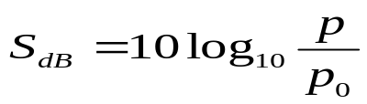
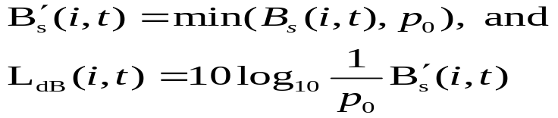
Feature Extraction – Loudness Sensation
Decibel → Phon → Sone
  The dB value of a sound is calculated as the ratio between its pressure and the pressure of the hearing threshold given by 20 uPa. The sound pressure level is calculated as:
  For our experiments we set the hearing threshold parameter as 1/0.35. The loudness matrix in decibel, L_{dB} is calculated as follows

Slide 20
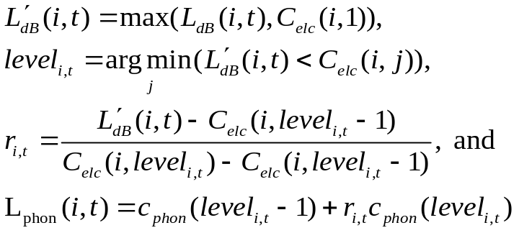
Feature Extraction – Loudness Sensation
Decibel → Phon → Sone (Cont …)
  The Phon is defined using the 1 kHz tone and the decibel scale. A pure tone at any frequency with 40 Phon is as loud as a pure tone with 40 dB at 1 kHz
  The loudness matrix in Phon, L_{Phon} can be calculated using the equal loudness contour matrix C_{elc} and the corresponding phone values to each contour C_{Phon} . C_{elc}(i;j) contains the dB values of the j-th loudness contour at the i-th critical band. Values in between two equal loudness contours are interpolated linearly, as follows:

Slide 21
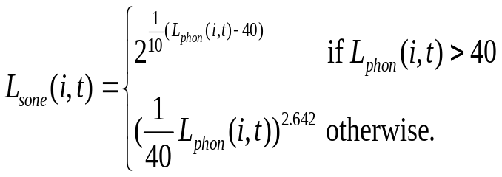
Feature Extraction – Loudness Sensation
Decibel → Phon → Sone (Cont …)
  From loudness level L_{Phon} the specific loudness sensation L_{Sone} per critical band following R.Bladon^{[16]}, is calculated as follows:

Slide 22
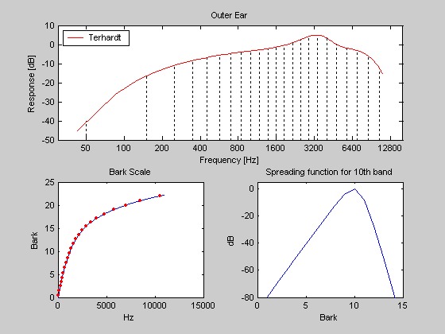
Feature Extraction – Loudness Sensation
The main characteristics of the sone model. The upper subplot shows the width of the critical-bands and the outer-ear model. The lower left shows the relationship between the Bark-scale and Hz. The lower right shows the spectral masking function. Some things to notice: The Bark-scale is linear up to about 500Hz. The spectral masking is not symmetric. Higher tones are masked stronger by lower ones than vice versa. The outer-ear is most responsive to frequencies around 3-4 kHz.

Slide 23
Feature Extraction – Loudness Sensation
System architecture of Sonogram Calculation
Power Spectrum
Window Size = 23 msec
Overlap = 50%
Applying Outer Ear Model proposed by Terhardt 1979
Frequency Bundling in 24 Critical Bark Banks
(Zwicker & fastl 1999)
Loudness calculated in Phon as proposed by Zwicker & fastl.
Calculate Loudness first in Decibel-Sound Pressure Level i.e. dBSPL
Calculating Spectral Masking per band
(B.S.Atal 1979 JASA)
Finally Loudness calculated in Sone
(Bladon and Lindblom, 1981, JASA)
SONOGRAM
Cb x no. of frames

Slide 24
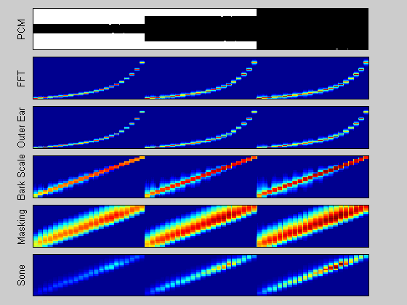
Feature Extraction – Loudness Sensation
The characteristics of the sone model can be demonstrated with a simple sine-tone. The tone is generated at different frequencies (center frequencies of the critical-bands) with fixed amplitude (3 times, each time the fixed amplitude is increased). Note the difference between the linear frequency scale (used in the outer-ear and FFT representations) and the Bark-scale (the lower 3 subplots). The sinusoids in each sweep from low to high have the same amplitudes, they are not perceived equally loud. This pitch dependent loudness sensation is reflected in the model (in contrast to the MFCC model).

Slide 25
Feature Extraction – Loudness Sensation
SONOGRAM
Cb x no. of frames
Normalization of Sonogram
Sone=Sone/ (max (Sone))
Spectrum Histogram Calculation
Cb=24, hist_res=40
Centers = linspace (1/hist_res, 1, hist_res)
For i=1:hist_res
For j=1:Cb
Sh(j,i)=sum(sone(j,:)>=centers(i));
End
End
Spectrum Histogram
Cb x Hist_res
System architecture of Spectrum Histogram (SH) Calculation

Slide 26
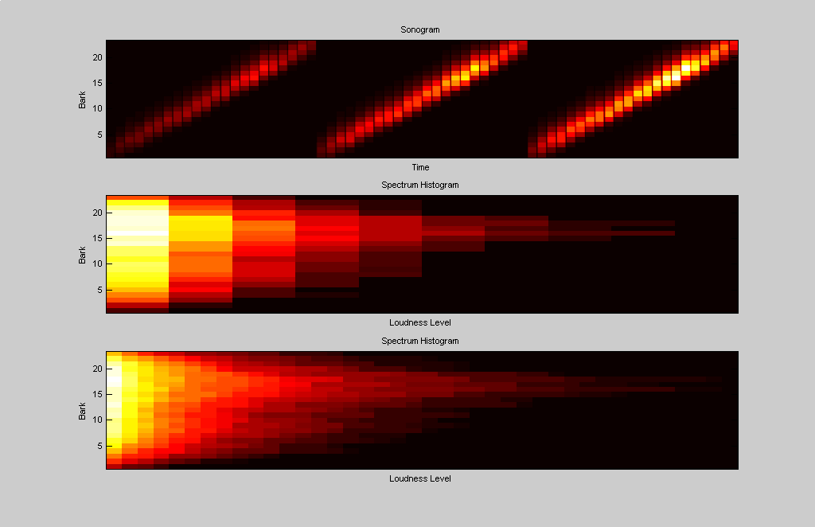
Feature Extraction – Loudness Sensation
Same test sound as in the examples above. The spectrum histogram counts how often a loudness level was exceeded in each critical-band. Two spectrum Histogram are shown with hist_res=10 and hist_res=25 respectively.

Slide 27

Feature Extraction - Dynamics
Amplitude Modulated Loudness
  The loudness of a critical-band usually rises and falls several times. Often there is a periodical pattern, also known as the rhythm
  The periodical patterns of this signal can then be assumed to originate from a mixture of sinusoids. These sinusoids modulate the amplitude of the loudness, and can be calculated by a Fourier transform.
  Modulation frequency are in the range from 0 to 43 Hz with an accuracy of 0.17 Hz. Modulation amplitude delta L_{i}(n) with the frequency of the i-th critical band is calculated as:

Slide 28
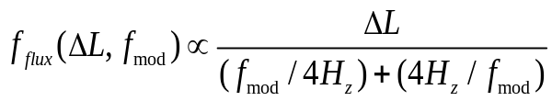

Feature Extraction - Dynamics
Fluctuation Pattern (FP) Strength
  The amplitude modulation of the loudness has different effects on our sensation depending on the frequency
  The sensation of fluctuation strength [13] is most intense around 4Hz and gradually decreases up to a modulation frequency of 15Hz
  The fluctuation strength of a tone with the loudness delta L, which is 100% amplitude modulated with the frequency fmod can be expressed by,
  The modulation amplitudes F(i; n) of the i-th critical-band are weighted according to the fluctuation strength sensation as follows,

Slide 29
Feature Extraction - Dynamics
Amplitude Modulation of Loudness Sensation per critical Band is calculated for each 6-second sequence using FFT in the range 0-10 Hz
Amplitude Coeffs. are weighted based on Psychoacoustics model of Fluctuation Strengths (Fastl 1982). This is done to reduce influence of very low modulation frequencies which generally have higher energies.
SONOGRAM
Finally to obtain a single model per piece of music based on its 6-second sequences, the median of corresponding sequences is calculated
To distinguish certain rhythmic patterns and to reduce irrelevant information gradient and Gaussian filters are applied
For each 6-sec sequence we have 1440 fluctuation strength values for 24 critical banks and 60 modulation frequencies from 1 to 10 Hz.
Prior to organizing music with SOM, dimensionality of FP’s is reduced from 1440 to 80 using Principle Component Analysis. This is done because FP strengths are highly correlated and not all 1440 values contain relevant information.
Fluctuation Patterns
Cb x 60 mod. Freq.
System Architecture for Fluctuation Pattern Calculation

Slide 30
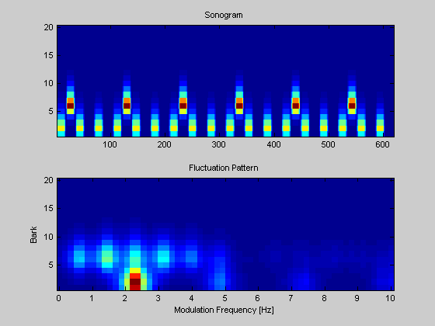
Feature Extraction - Dynamics
Final Result after computing the fluctuation pattern for a 6sec sequence.

Slide 31
Feature Extraction – Periodic Histogram (PH)
Process using a half wave rectified differential filter on each critical band to emphasize percussive sound
12 Second window with 50 % overlap are further used. After Hann windowing, comb filter is applied to each critical band with a 5 bpm resolution in the range 40 bpm to 240 bpm
SONOGRAM
Hence for every 6 second sequence of the song, we get 40 values representing strength of beats with tempo ranging from 40 to 240 bpm
To emphasize the peaks we use a full wave rectified differential filters before summing up the amplitudes for each periodicity over all bands
Further resonant model of Moelant’s is applied with beta = 4 to the amplitudes obtained from the comb filters.
To summarize this information for whole piece of music, a histogram (2-D) with 40 equally spaced columns representing different tempos and 50 rows representing strength levels is used. Histogram counts for each periodicity, how many times a level equal or higher than a specific value was reached. This preserves the information on the distributions of strength levels over time.
Periodic Histograms
50 (beat strength) x 40 (beat)

Slide 32
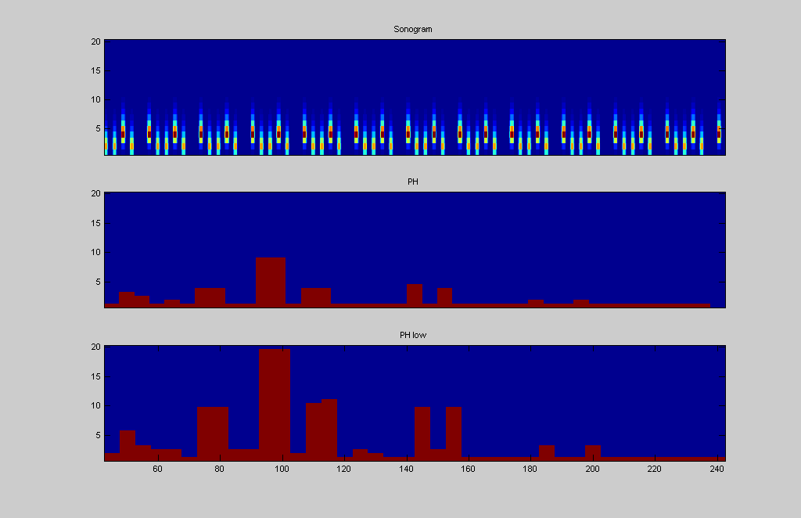
Feature Extraction – Periodic Histogram (PH)
If the input is long enough, then the results from each 12sec frame are summarized in a histogram, counting for each periodicity (bpm) how often specific energy levels were exceeded.

Slide 33
Clustering – Self Organizing Maps (SOM)
Background
  The goal of clustering data is to find groups (clusters) of data items that are similar to each other and different from the rest of the dataset
  The SOM was developed in 1981 as an artificial neural network, which models biological brain functions. Since then it has undergone thorough analysis ^{[Koh01]}.
  An example for the efficiency of the SOM is the WebSOM1 project

Slide 34
Clustering – Self Organizing Maps (SOM)
Batch SOM Algorithm
  Batch SOM algorithm is significantly faster and has one parameter less to adjust
  Batch SOM algorithm consists of two steps:
    First the distance between all data items x_{i} and the model vectors m_{j} is computed and each data item i is assigned to the unit that represents it best C_{i}. V_{j} represents the vernoi set of data items which are best represented by unit m_{j}
    In the second step each model vector is adapted to better fit the data it represent. The model vector mj is adapted not only according to Vj but also in regard to the vernoi set of the units in the neighbourhood
    A neighbourhood function is used to decide the influence of vernoi set of the units in the neighbourhood upon mj

Slide 35
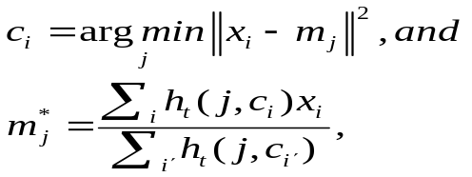
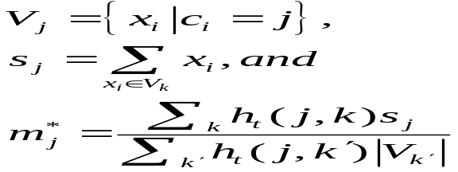
Clustering – Self Organizing Maps (SOM)
Batch SOM Algorithm (Cont …)
  The two steps of the batch SOM algorithm can be formulated as:

Slide 36
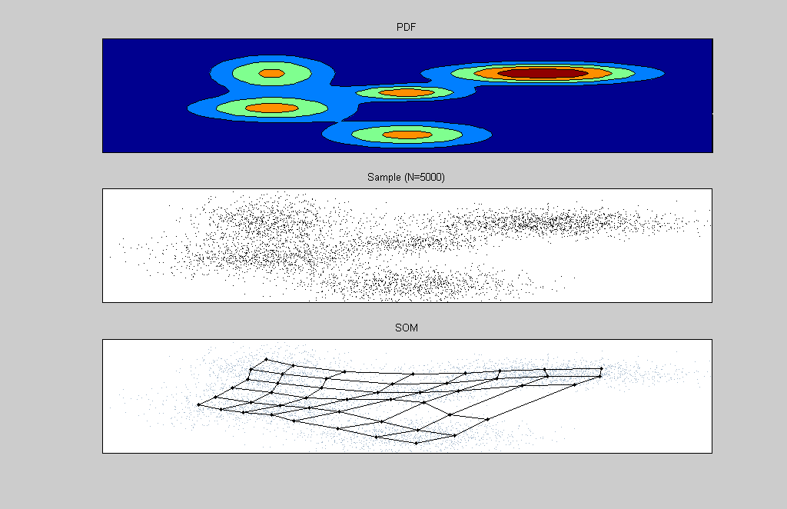
Clustering – Self Organizing Maps (SOM)
A test result after running SOM Algorithm on the above shown 5 clusters

Slide 37
Visualization and User Interface
SOM maps could be used as user interface. Similar songs are located close together on the map
While these maps surely are a bigger help there are two major deficiencies:
  The first is the lacking support trying to understand the cluster structure. It is rather difficult to recognize clusters on the first sight
  The second deficiency derives from the assumption that the music collection and the contained pieces of music are unknown to the user
We made use of Smooth Data Histogram (SDH) which aim at creating a more intuitive user interface

Slide 38
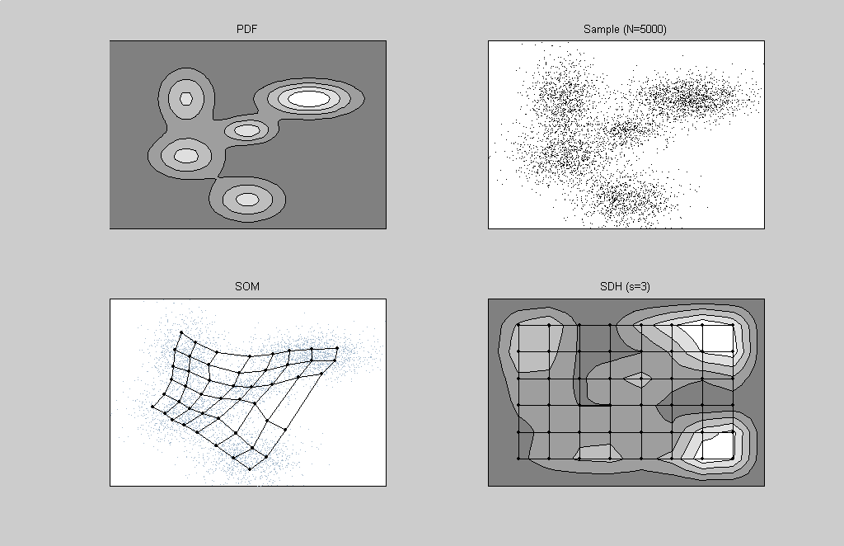
Visualization and User Interface (Cont …)
A Smooth Data Histogram representation of results obtained by SOM algorithm

Slide 39
Visualization and User Interface (Cont …)
Island of Music (IOM)
  We use the metaphor of islands to visualize our music collection
  The metaphor is based of islands, which represent similar data items (piece of music)
  These islands are surrounded by seas, which to correspond to areas on the map where data items, which do not belong to specific clusters can be found
  There can be land passage between island which indicate that there are connections between the two clusters
  Within an island there might be sub-clusters, mountains and hills represent these sub-clusters

Slide 40
Visualization and User Interface (Cont …)
Island of Music (IOM) – Color technique used
  A simple approximation of the probability density function is visualized using a color scale which ranges from:
    dark blues (deep seas)
    light blue (shallow water)
    yellow (beach)
    dark green (forest)
    light green (hills)
    gray (rocks), and finally
    white (snow)

Slide 41
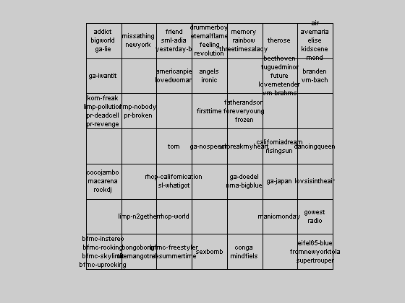
Visualization and User Interface (Cont …)
SDH Results after applying SOM algorithm on a dataset of 77 songs from various genres

Slide 42
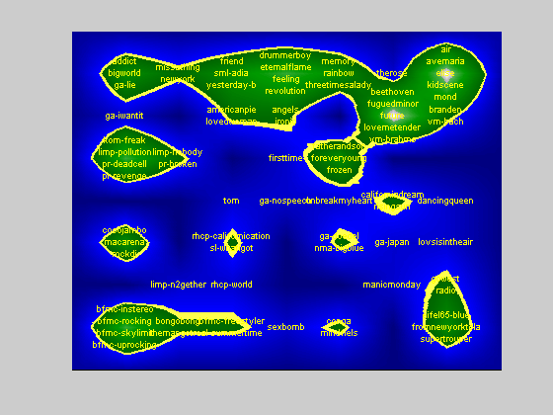
Visualization and User Interface (Cont …)
Final Island of Music for the test database of 77 songs

Slide 43
Visualization and User Interface (Cont …)
Island of Music (IOM)
  The density function is estimated as follows:
    Each piece of music votes for the clusters (map units), which represents it best
    The first closest model vector of the corresponding units gets n points, the second n-1, the third n-2 and so on
    Hence units that are close to several pieces of music will get many points. While clusters which are not close to any piece, will hardly have any point
    Using n=3 connects more islands and lets them grow bigger
    The higher ‘n’ gets, the more islands will become connected
    The visualization has been implemented using interpolating units, which do not have any corresponding model vector and are only assigned interpolated values of the approximated density function

Slide 44
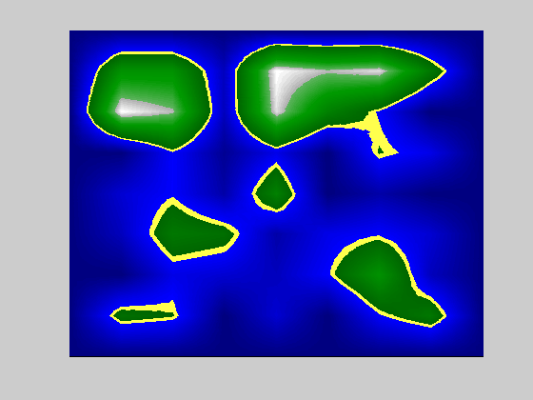
Visualization and User Interface (Cont …)
Island of Map with Voting N=3

Slide 45
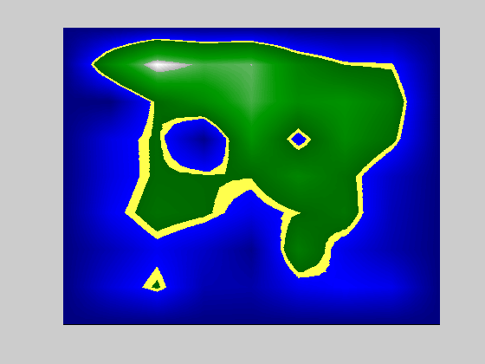
Visualization and User Interface (Cont …)
Island of Map with Voting N=10

Slide 46
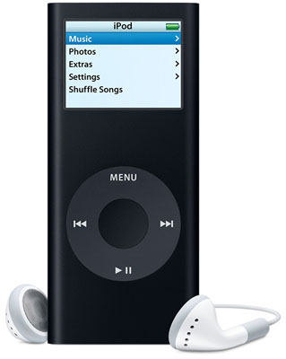
Visualization and User Interface (Cont …)

Slide 47
Conclusion and Future Work
Summary
  We used techniques from field of Signal Processing, Psychoacoustics, Image Processing and Data Mining to develop a system which automatically builds a graphical user interface to music archives
  We computed perceived similarity of two pieces of music and used neural network algorithm namely, SOM to organize the piece of music, so that similar pieces of music are located close together on a 2-D display
Future Work
  One major problem in developing these systems is the loudness of the piece of music. Methods to normalize the loudness would increase the quality of the system

Slide 48
Conclusion and Future Work (Cont …)
Future Work (Cont …)
  Another interesting aspect is the sequencing. We used audio pieces of 6 second long, and used only a small subset of these pieces was used. Using more sequences and even overlapping them can provide better results
  The applied image processing filters need to be evaluated more thoroughly as well. Alternative parameter settings as well as alternative filters should be considered

Slide 49
References
[1] F. Nack and A. Lindsay. Everything you wanted to know about MPEG7 - Part 1. IEEE MultiMedia, pages 65–77, July/September 1999.
[2] G. Peeters, S. McAdams, and P. Herrera. Instrument Sound Description in the Context of MPEG-7. In Proceedings of the ICMC2000, 2000.
[3] A. Rauber and D. Merkl. The SOMLib Digital Library System. In Proceedings of the 3rd Europ. Conf. On Research and Advanced Technology for Digital Libraries (ECDL’99), Paris, France, 1999. Lecture Notes in Computer Science (LNCS 1696), Springer.
[4] S. Kaski, T. Honkela, K. Lagus, and T. Kohonen. WEBSOM-self organizing maps of document collections. Neurocomputing, 21:101–117, 1998.
[5] J. Foote. An overview of audio information retrieval. Multimedia Systems, 7(1):2–10, 1999.
[6] M. Liu and C. Wan. A Study of Content-Based Classification and Retrieval of Audio Database. In Proceedings of the 5th International Database Engineering and Applications Symposium (IDEAS’2001), Grenoble, France, 2001. IEEE.
[7] J. T. Foote. Content-based retrieval of music and audio. In C. Kuo, editor, Proceedings of SPIE Multimedia Storage and Archiving Systems II, volume 3229, pages 138–147, 1997.
[8] B. Logan. Mel Frequency Cepstral Coefficients for Music Modelling. In International Symposium on Music Information Retrieval (MUSIC IR 2000), Plymouth, Massachusetts, 2000.
[9] E. D. Scheirer. Music-Listening Systems. PhD thesis, MIT Media Laboratory, 2000.
[10] M. Fruhwirth and A. Rauber. Self-Organizing Maps for Content-Based Music Clustering. In Proceedings of the 12th Italien Workshop on Neural Nets (WIRN01), Vietri sul Mare, Italy, 2001. Springer.
[11] T. Kohonen. Self-Organizing Maps, volume 30 of Springer Series in Information Sciences. Springer, Berlin, 3rd edition, 2001.
[12] E. Zwicker and H. Fastl. Psychoacoustics, Facts and Models, volume 22 of Springer Series of Information Sciences. Springer, Berlin, 2nd updated edition, 1999.

Slide 50
References (Cont …)
[13] H. Fastl. Fluctuation strength and temporal masking patterns of amplitude-modulated broad-band noise. Hearing Research, 8:59–69, 1982.
[14] E. Zwicker, G. Flottorp, and S. S. Stevens. Critical band width in loudness summation. Journal of the Acoustical Society of America, 29:548–557, 1957.
[15] E. O. Brigham. The Fast Fourier Transform. Prentice Hall, Englewood Cliffs, NJ, 1974.
[16] R. Bladon. Modeling the judgment of vowel quality differences. Journal of the Acoustical Society of America, 69:1414–1422, 1981.
[17] S. Weil. Music Analysis and Characterization. Student Project (CS 152 - Neural Networks), Harvey Mudd College, Claremont, CA. http://www.newdream.net/~sage/nn, 1999.
[18] D. P. W. Ellis. Prediction-Driven Computational Auditory Scene Analysis. PhD thesis, MIT Department of Electrical Engineering and Computer Science, Cambridge, MA, 1996.
[19] A. K. Jain, M. N. Murty, and P. J. Flynn. Data Clustering: A Review.ACM Computing Surveys, 31(3):264–323, 1999.
[20] T. Kohonen. Self-organizing formation of topologically correct feature maps. Biological Cybernetics, 43:59–69, 1982.
[21] C. M. Bishop, M. Svens´en, and C. K. I. Williams. GTM: A principled alternative to the Self-Organizing Map. Proceedings of ICANN’96, International Conference on Artificial Neural Networks, volume 1112 of Lecture Notes in Computer Science, pages 165–170, Berlin, 1996. Springer.
[22] J. W. Sammon. A nonlinear mapping for data structure analysis. IEEE Transactions on Computers, 18:401–409, 1969.
[23] T. Kohonen. New developments of learning vector quantization and the self-organizing map. In SYNAPSE’92, Symposium on Neural Networks, Osaka, Japan, 1992. Alliances and Perspectives in Senri.
[24] D. Hearn and M. P. Baker. Computer Graphics, C Version. Prentice Hall, NJ, 2nd edition, 1997.

